Slide 1

WOOHP
To gang or not to gang ?

Slide 2
What the [blank] are the totally spies ?
French animated serie from the 2000s
Into some shady stuff...

Slide 3
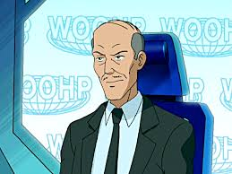
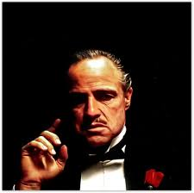
Hear me out
It is suspiciously similar to a gang, don't you think ?
=

Slide 4

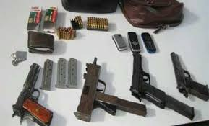
Hear me out
It is suspiciously similar to a gang, don't you think ?
=

Slide 5
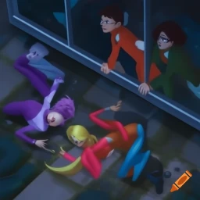
Hear me out
They even break into buildings !
=

Slide 6

But they do some things odds for a gang...

Slide 7

This raises a bigger question.

Slide 8
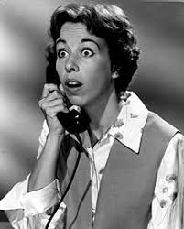
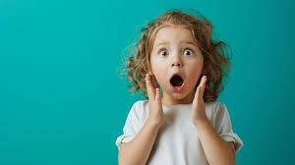

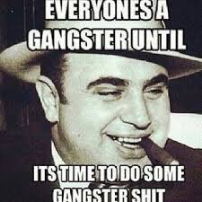
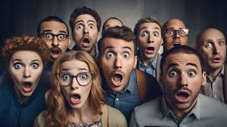
Are there good and bad gangs ?
PABLO

Slide 9

Pros:
They literally are a gang doing stuff for the well being of humanity
Some gangs are surely like them, right ?

Slide 10
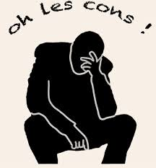
Cons:
THE
They commit all sorts of fellonies on a daily basis
They lie to teenagers

Slide 11

What should I remember about this presentation, after all ?
I hope something

Slide 12

Ty for listening to us

